Slide 1

CSE7101- Capstone Project
Eye-Gaze Integrated Attention U-Net for Accurate Medical Image Segmentation
Batch Number: CDV_20
Under the Supervision of,
Ms. Meena kumari K S
Assistant Professor
School of Computer Science and Engineering
Presidency University
Roll Number | Student Name
20221CDV0042 | Mahima Dorcas Pereira
20221CDV0043 | Nayana B N
20221CDV0045 | Tushar L G
Name of the Program: Devops
Name of the HoD: Dr. Pravintharaja S
Name of the Program Project Coordinator: Dr. H M Manjula
Name of the School Project Coordinators: Dr. Sampath A K

Slide 2
Problem Statement Number:
Organization: AICTE, MIC-Student Innovation
Category : Software
Problem Description:
Medical image segmentation is crucial for detecting diseases like breast cancer. But existing AI models struggle due to:
Limited annotated medical datasets.
Large variation in lesion sizes (tiny calcifications vs. large masses).
High annotation cost for radiologists.

Slide 3
Content
Problem Statement
Objectives
Background and Related work for title Selection
Analysis of Problem Statement
Innovation or Novel Contributions
Git-hub Link
Timeline of the Project
References

Slide 4
Analysis of Problem Statement
OBJECTIVE:
Develop a deep learning model that integrates eye-tracking data as weak supervision.
Improve segmentation accuracy for both small and large lesions.
Build a preprocessing pipeline for gaze data collection and attention mapping.
Evaluate robustness under limited data and noisy gaze inputs.

Slide 5
Analysis of Problem Statement
Background and Related Work:
U-Net & Variants (UNet++, Attention U-Net, TransUNet) → Strong baselines for medical segmentation.
Eye-tracking in radiology → Shows where experts focus during diagnosis.
Prior work like Gaze2Segment treated gaze as an annotation, but your project integrates gaze directly into training, making it more adaptable.

Slide 6
Analysis of Problem Statement
Technology Stack Components:
Programming: Python
Frameworks: PyTorch / TensorFlow, OpenCV, NumPy, Pandas
Visualization: Matplotlib, Seaborn
Version Control: Git, GitHub
Software and Hardware Requirements:
Hardware: A standard laptop or desktop computer with a webcam (720p or higher recommended).
Software: Python, PyTorch/TensorFlow, OpenCV, CUDA.

Slide 7
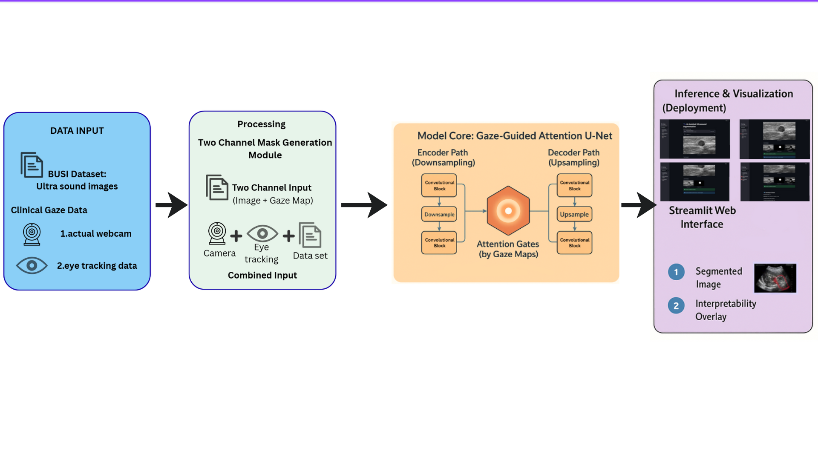
Analysis of Problem Statement
Architecture Diagram:

Slide 8
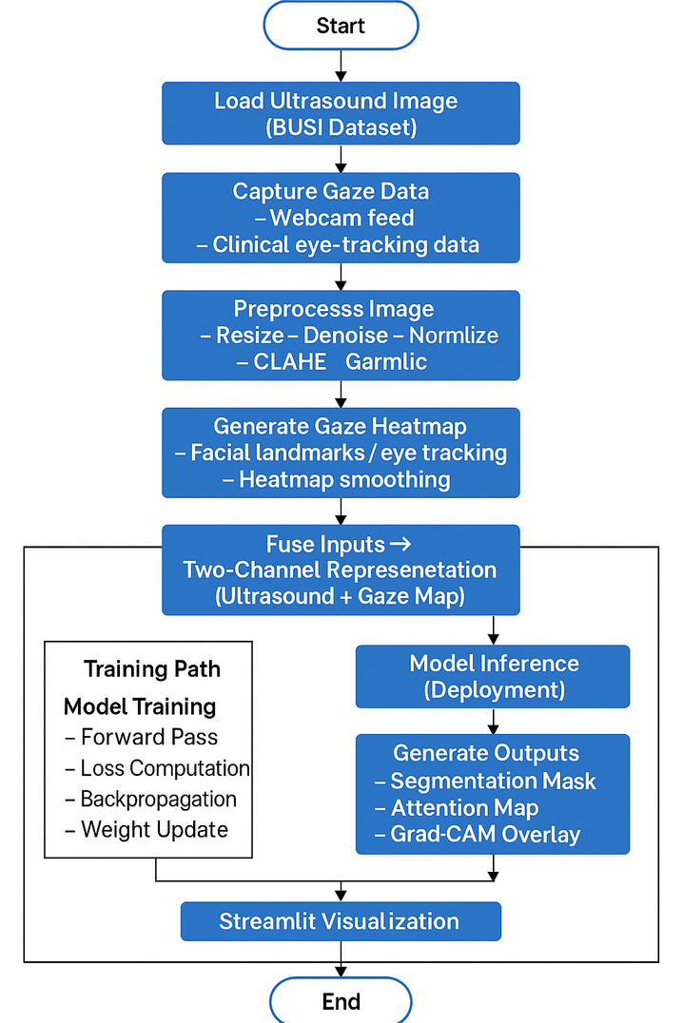
Analysis of Problem Statement
Flow Chart:

Slide 9
Analysis of Problem Statement
Algorithm:
Initialize the trained Gaze-Guided Attention U-Net model M.
function SegmentImage(image_file):
// 1. Data Acquisition
img_us ← Load and preprocess(image_file)
// Generate gaze map (example using proxy)
img_gaze ← GenerateGradCAMProxy(img_us, M)
// 2. Two-Channel Fusion
input_tensor ← Concatenate([img_us, img_gaze])
// 3. Segmentation Intelligence
predicted_mask ← M.predict(input_tensor)
// 4. Visualization
heatmap ← GenerateGradCAMVisualization(img_us, M)
// 5. Feedback to Deployment Layer.|human|>|human|>|human|>|human|>predictmask, heatmap. end function

Slide 10
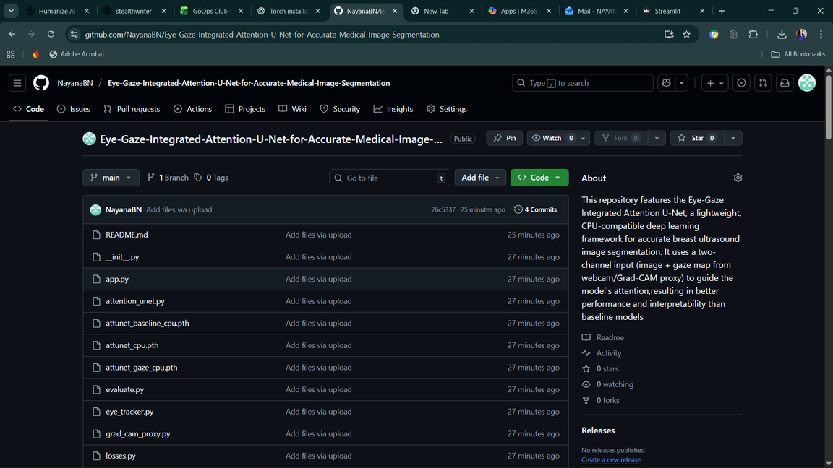
Github Link
The Github link provided should have public access permission.
Github Link:
https://github.com/NayanaBN/Eye-Gaze-Integrated-Attention-U-Net-for-Accurate-Medical-Image-Segmentation

Slide 11
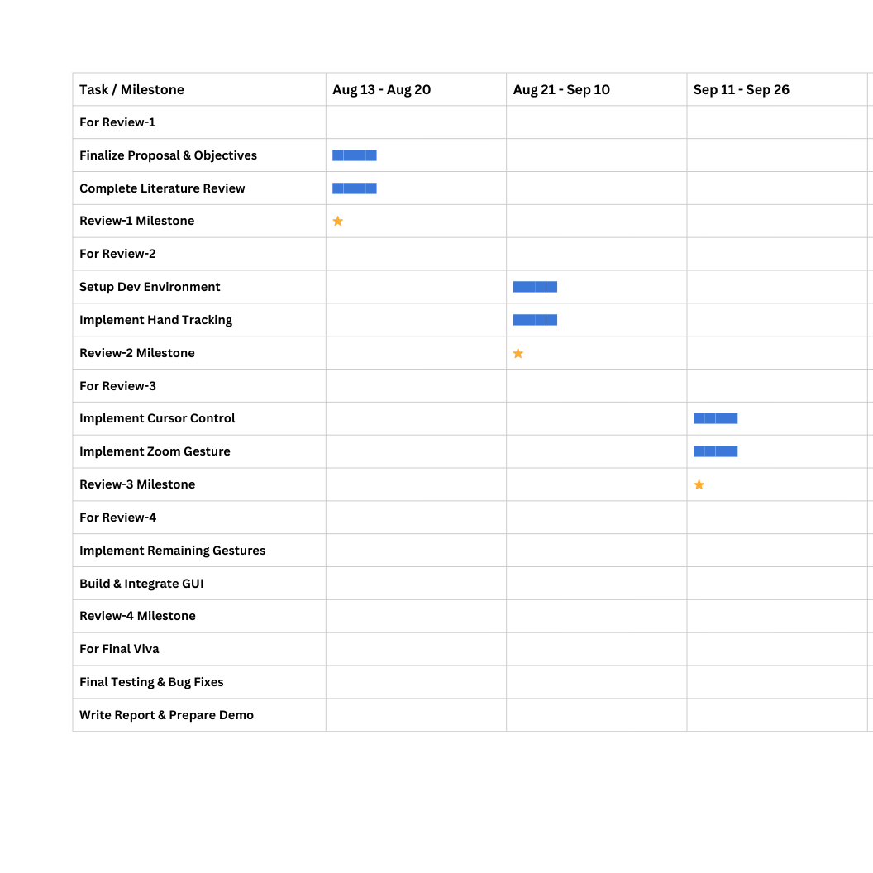
Timeline of the Project (Gantt Chart)

Slide 12
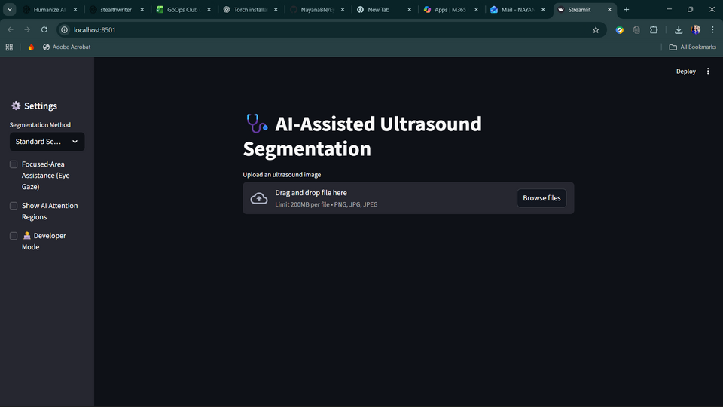
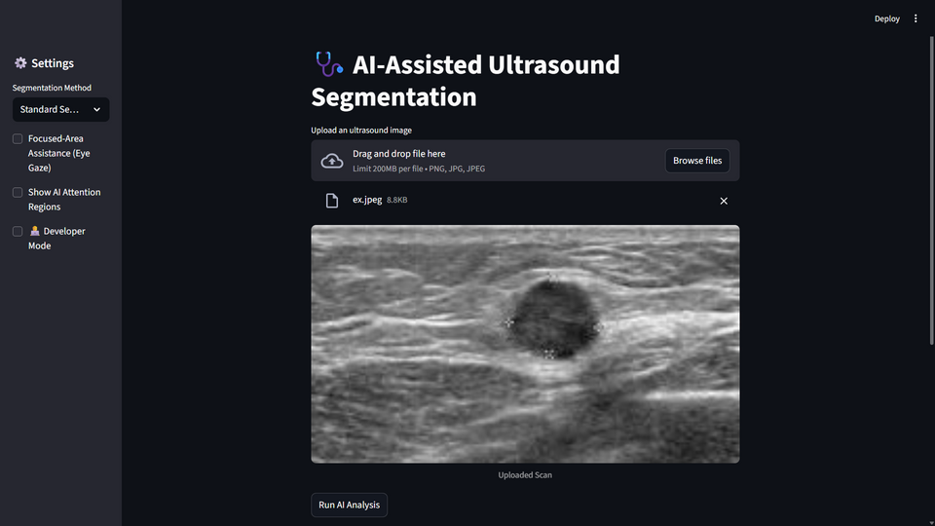
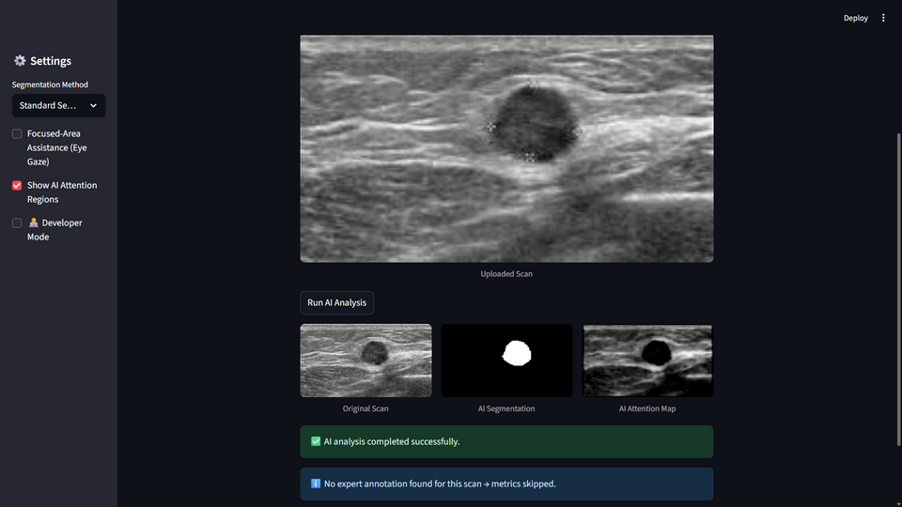
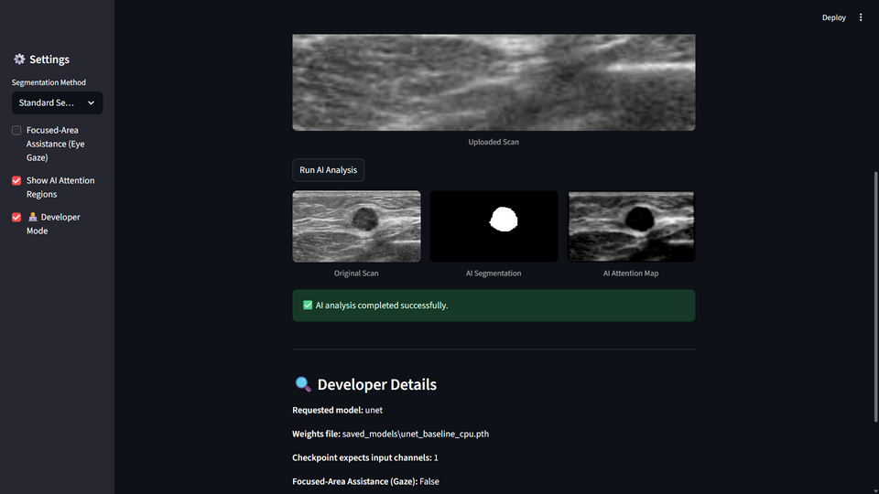
Results
fig.1 Dashboard
fig.2 Image Reading
fig.3 Heatmap
fig.4 Develpoer View

Slide 13
References (IEEE Paper format)
J. Xie et al., “Integrating Eye Tracking With Grouped Fusion Networks for Semantic Segmentation on Mammogram Images,” IEEE Transactions on Medical Imaging, vol. 44, no. 2, pp. 868–879, Feb. 2025.
A. Joshi and K. K. Sharma, “Dense Deep Transformer for Medical Image Segmentation: DDTraMIS,” Multimedia Tools and Applications, vol. 83, pp. 18073–18089, Feb. 2024.
I. Pacal, M. Alaftekin, and F. D. Zengul, “Enhancing Skin Cancer Diagnosis Using Swin Transformer with Hybrid Shifted Window-Based Multi-head Self-attention and SwiGLU-Based MLP,” Journal of Imaging Informatics in Medicine, vol. 37, pp. 3174–3192, Dec. 2024.
Y. Cai, Y. Long, Z. Han et al., “Swin Unet3D: a Three-Dimensional Medical Image Segmentation Network Combining Vision Transformer and Convolution,” BMC Medical Informatics and Decision Making, vol. 23, art. no. 33, Feb. 2023.
A. Joshi and K. K. Sharma, “Dense Deep Transformer for Medical Image Segmentation: DDTraMIS,” Multimedia Tools and Applications, vol. 83, pp. 18073–18089, Feb. 2024

